Slide 1


Follow me on
@michael_brady
michbrady
Michael
Brady

Slide 2

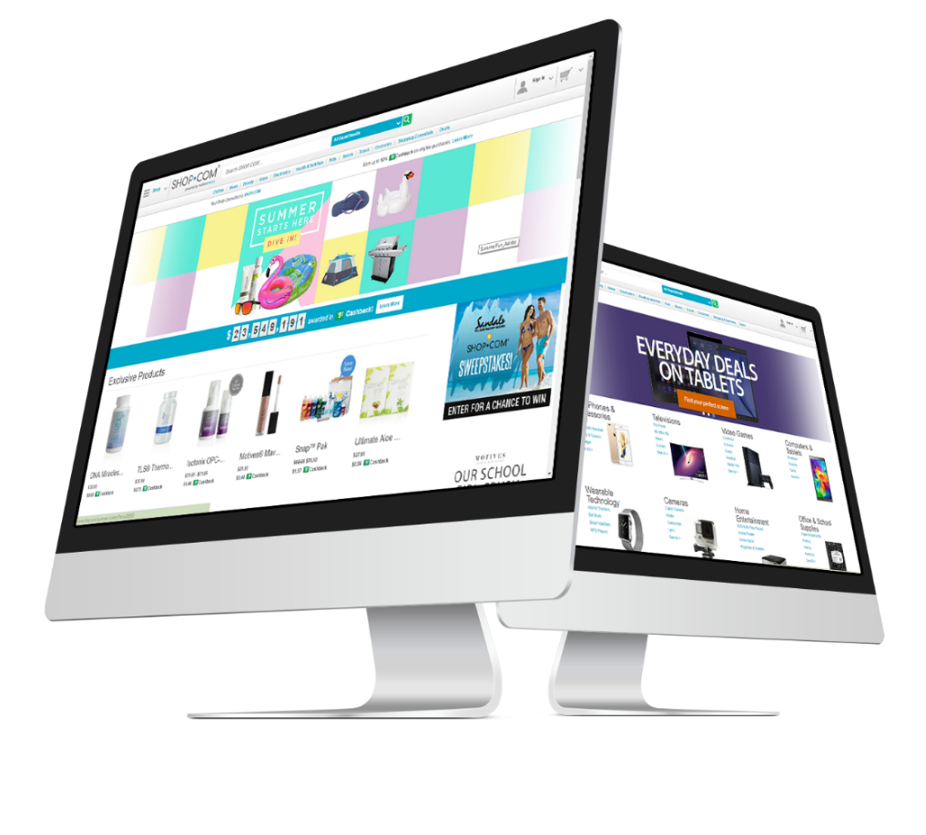
Innovation in Technology
Technology &
Business Insights
Notes:
To grow the business we must understand the business.
Why would you be part of this company?
We know it is a great company. Great opportunity!
Our company also has GREAT Technology. Not only great technology – but we innovate, we measure, monitor and improve.
We need to understand our technology for
speed/reliability
What are customers are doing? How they use the site?
What do they want?
Big data, visutalization

Slide 3

Our Infrastructure, Systems, Software
Large Scalable Infrastructure
highly
innovative
Cutting Edge
Technology

Slide 4
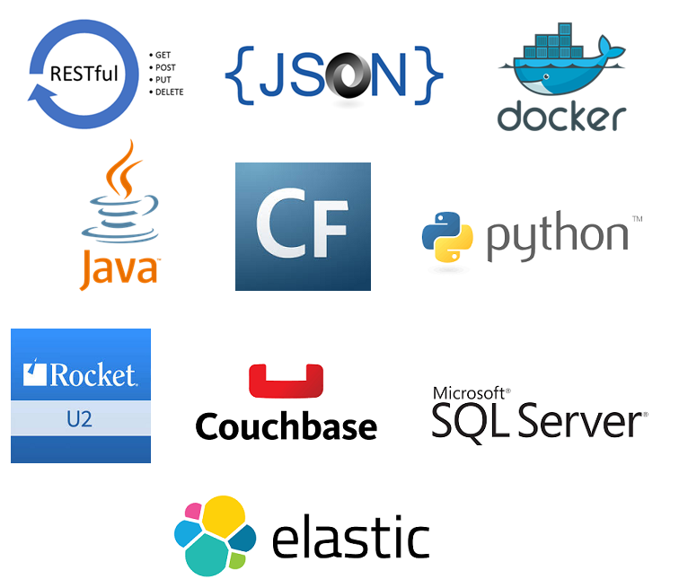
Technology
Stack

Slide 5
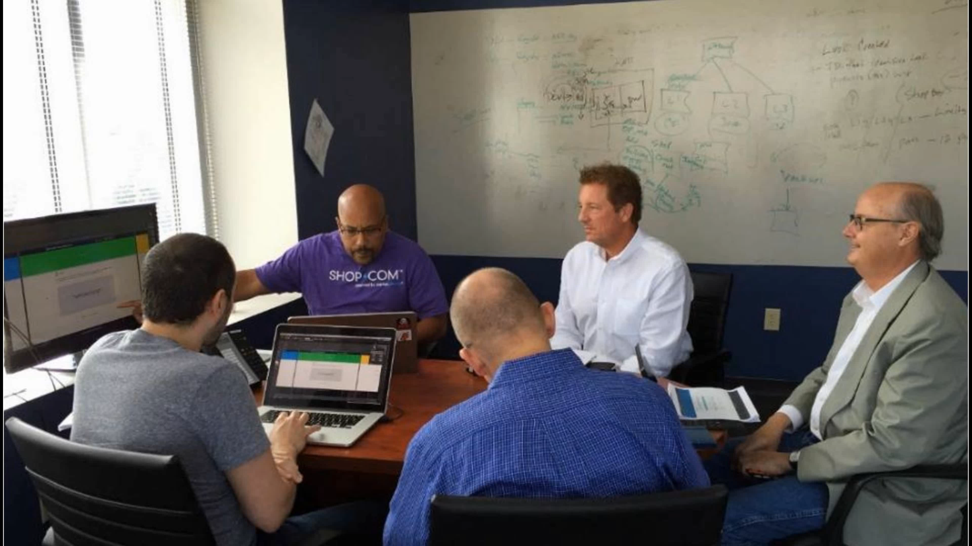
Over 300 strong
Developers
SYSTEM Engineers
Security
SPECIALISTS
Quality
Assurance
PROJECT
MANAGERS
BUSINESS
ANALYSTS
Devops (Systems)
architects
Release & deployment
Network ENGINEERS

Slide 6
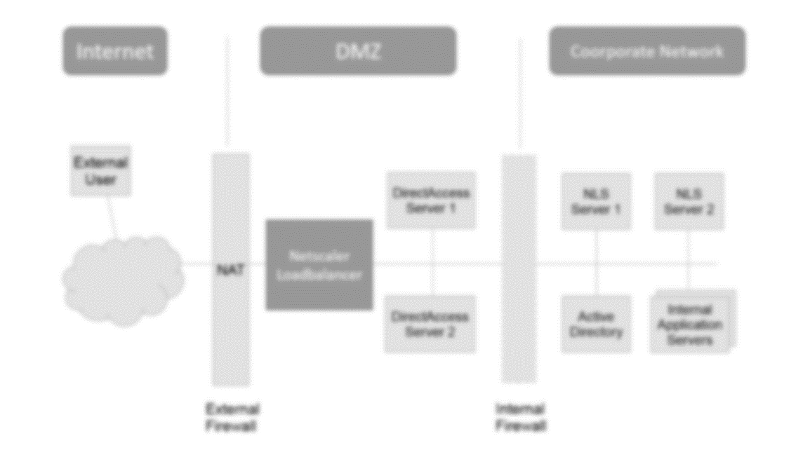
Security: infrastructure
Best in class:
Security & Network
Infrastructure

Slide 7







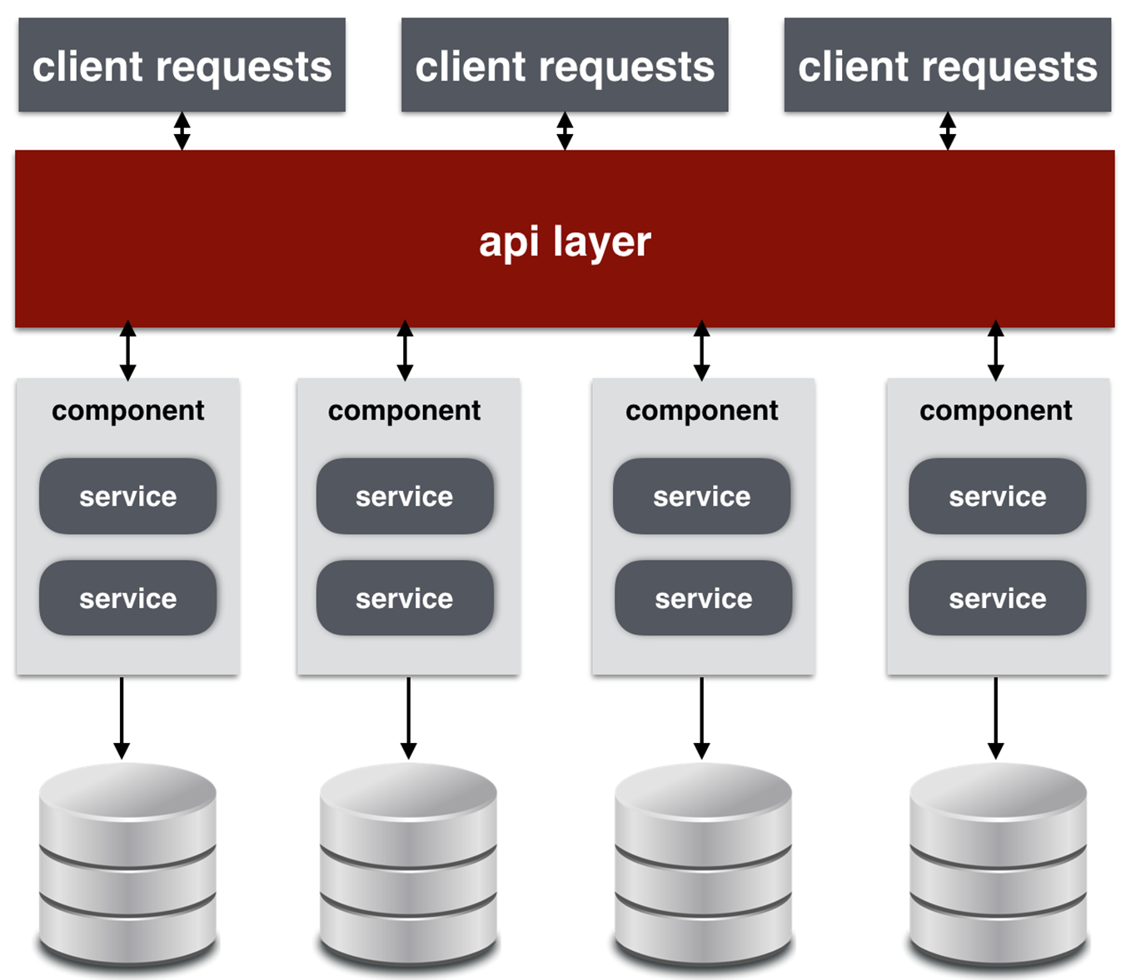


Security: infrastructure
Cache
Couchbase
Couchbase
Couchbase
Couchbase
Linux
Apache Tomcat
Linux
Apache Tomcat
Linux
Apache Tomcat
Linux
Apache Tomcat
Linux
Apache Tomcat
Linux
Apache Tomcat
Linux
Apache Tomcat
Linux
Apache Tomcat
Linux
Apache Tomcat
Linux
Apache Tomcat
Linux
Apache Tomcat
Linux
Apache Tomcat
Data Service Bus
Data Service Bus
Data Service Bus
Data Service Bus
Data Service Bus
Data Service Bus
SQL
UniVerse
CouchBase
mySQL
SQL
UniVerse
CouchBase
mySQL

Slide 8
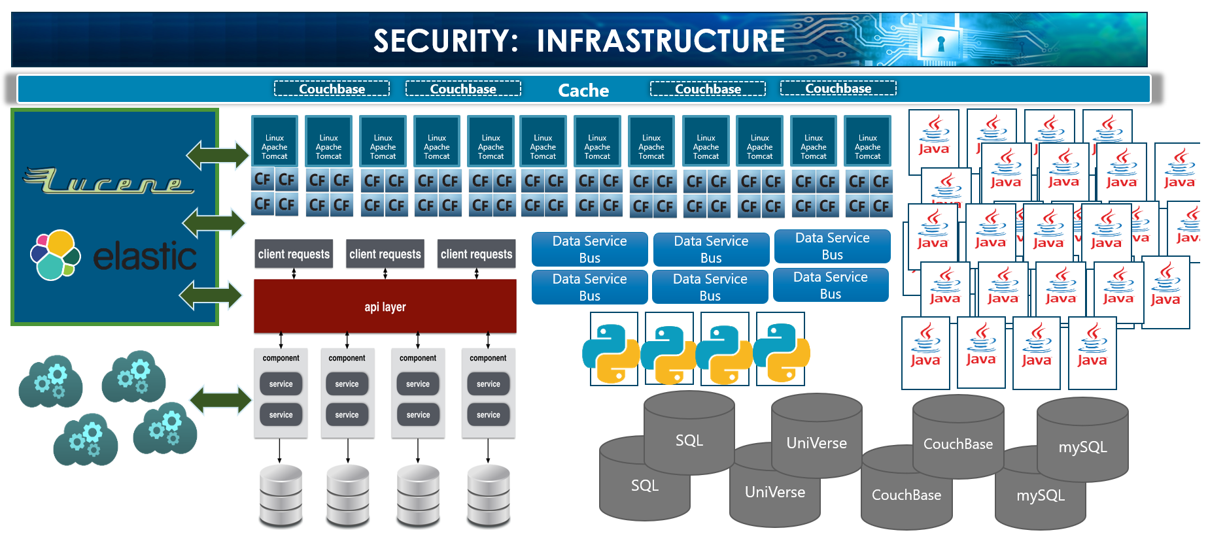

Slide 9
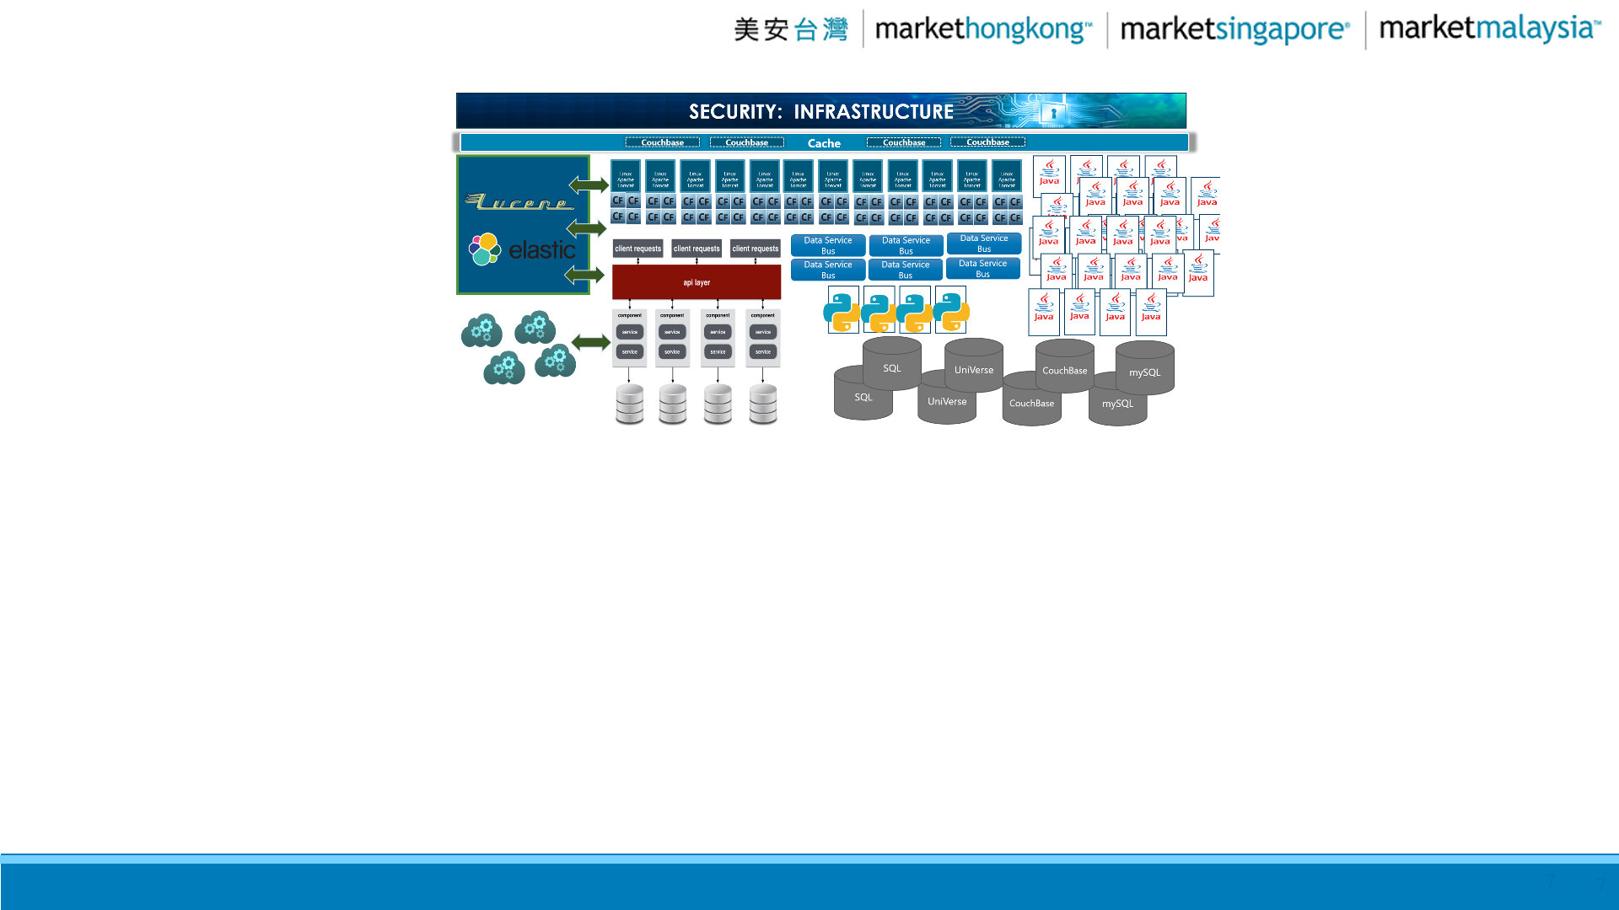
Mission critical
Fast and reliable websites
to serve our Customers and UFOs

Slide 10
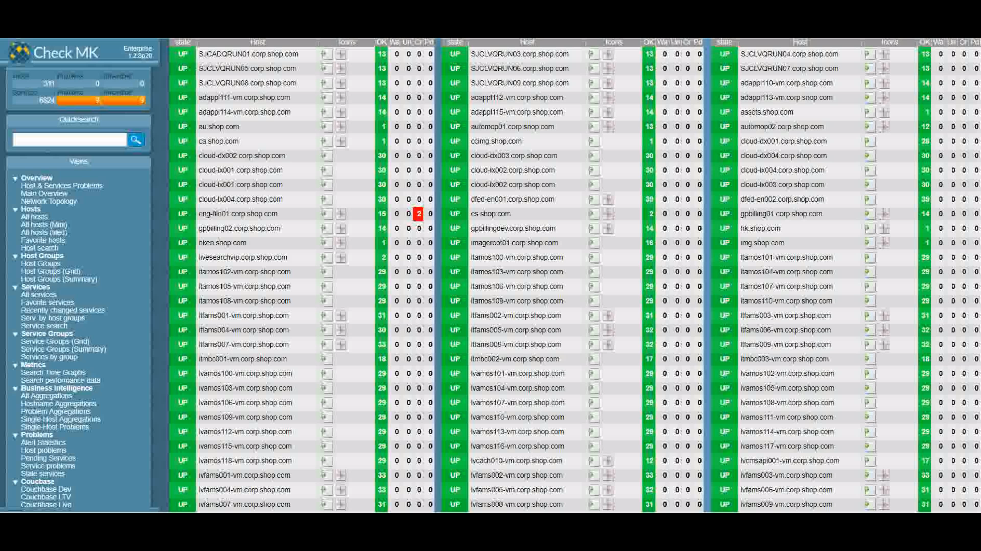
Systems - Server Monitoring and Alerts
Servers & Systems
949
53,108,874 monthly page views
4.23 million visitors monthly

Slide 11
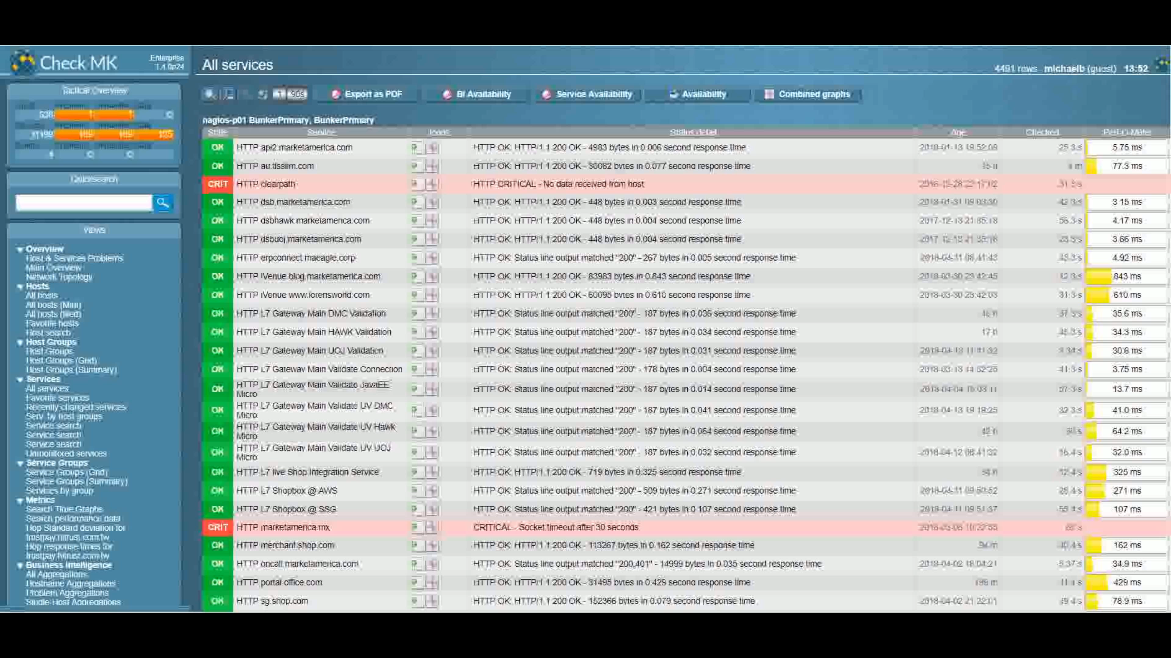
Services - Server Monitoring and Alerts
Services
18,023
53,108,874 monthly page views
4.23 million visitors monthly

Slide 12
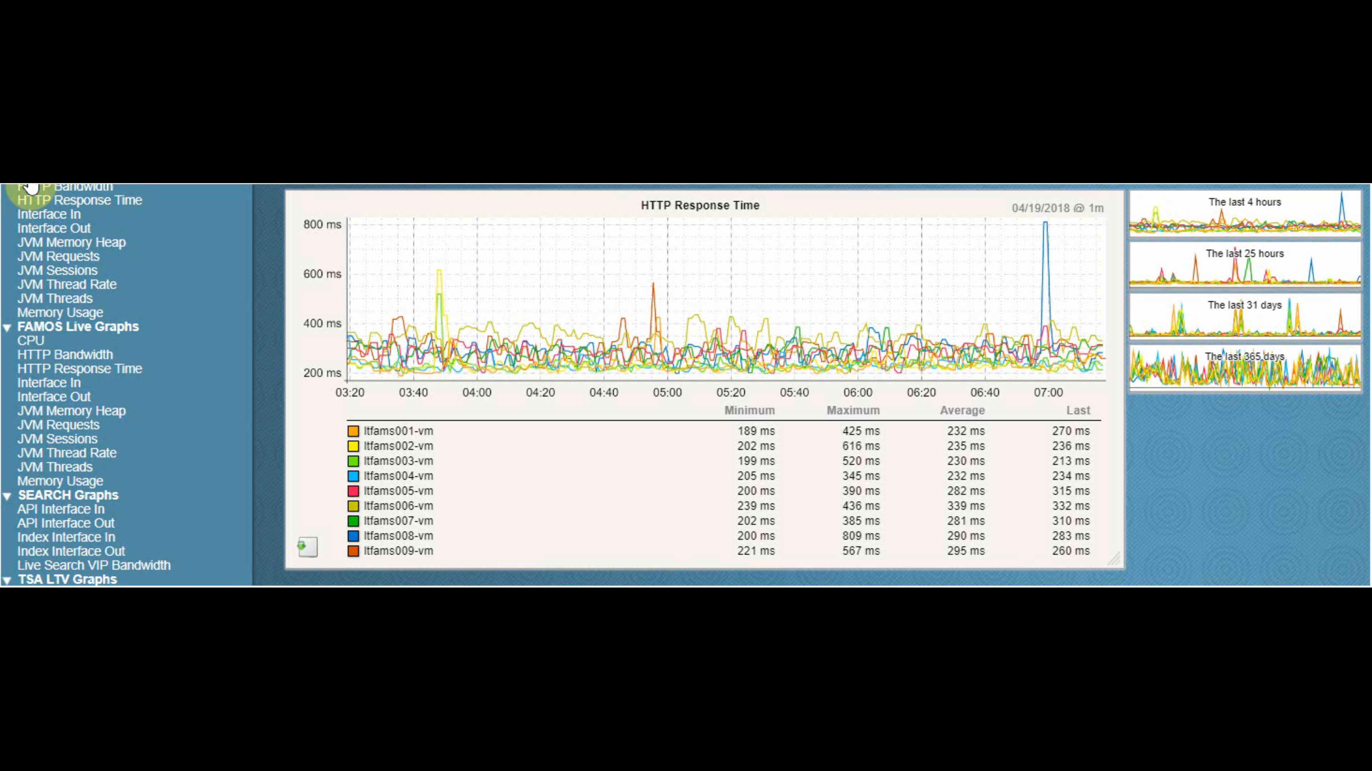
Analyzing our systems
That which is not measured, will not improve.
We measure and monitor everything.
Notes:
Analyzing our Systems.
That which is not measured, will not improve. We measure and monitor everything.
Why?
Improve performance of our systems. We can see if we introduced a problem in our code, or application. We can see disk impacts, CPU, network interface In/Out rates, service speeds – list goes on.

Slide 13
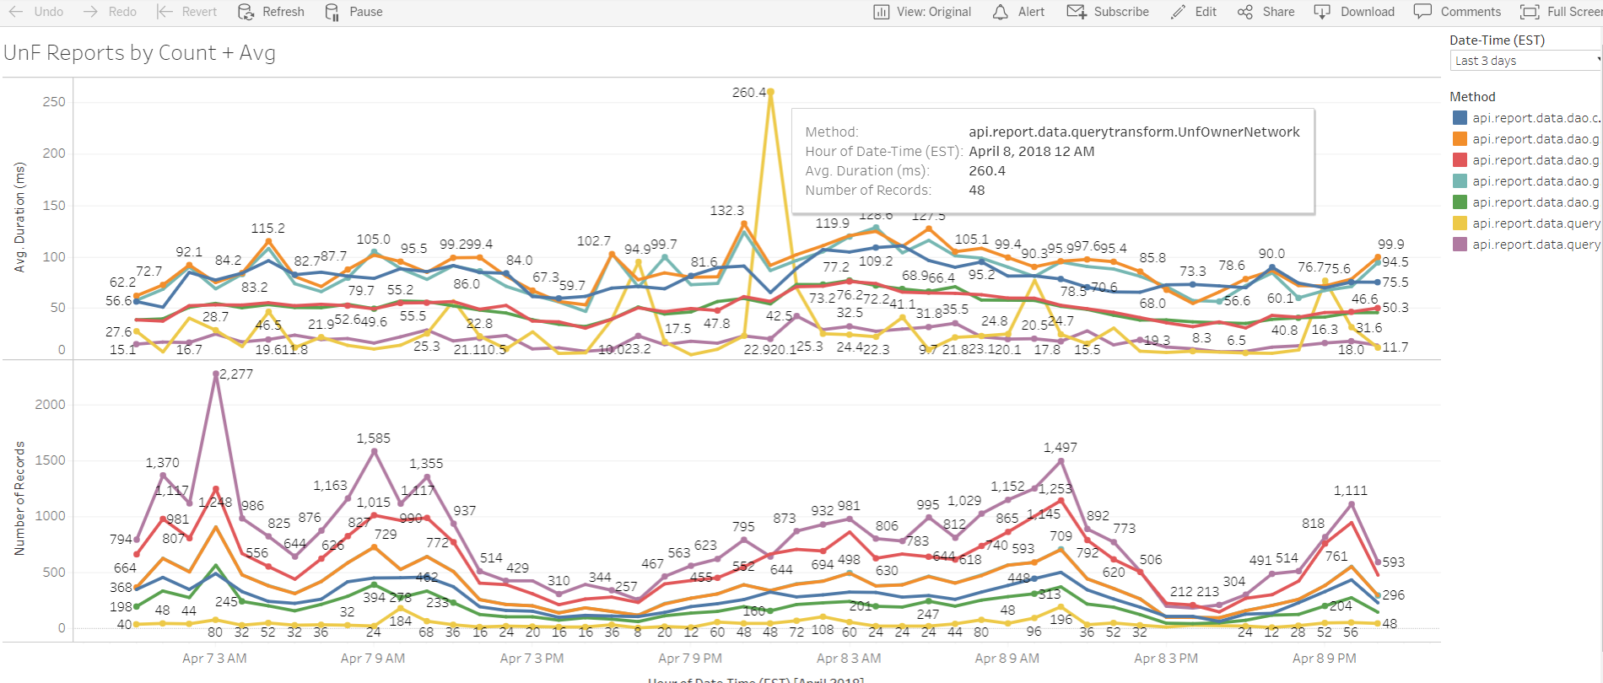
Visualization – Insights
Improving
Application performance

Slide 14
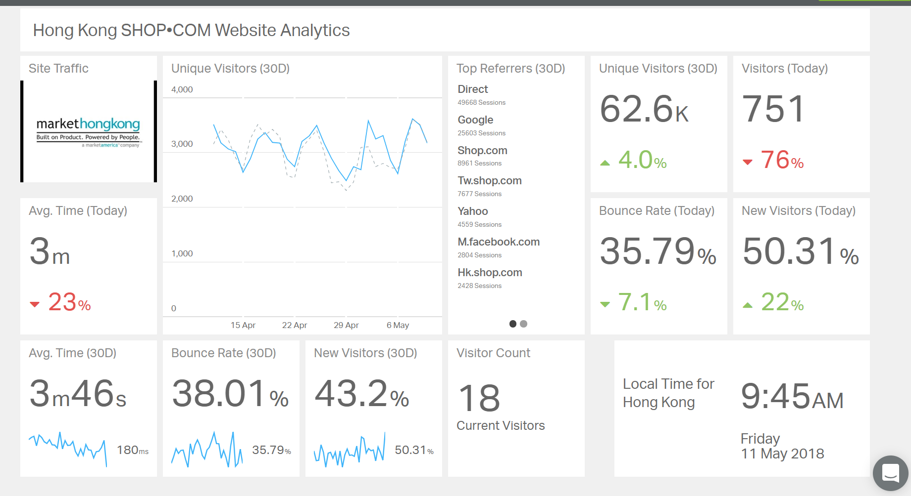

Slide 15
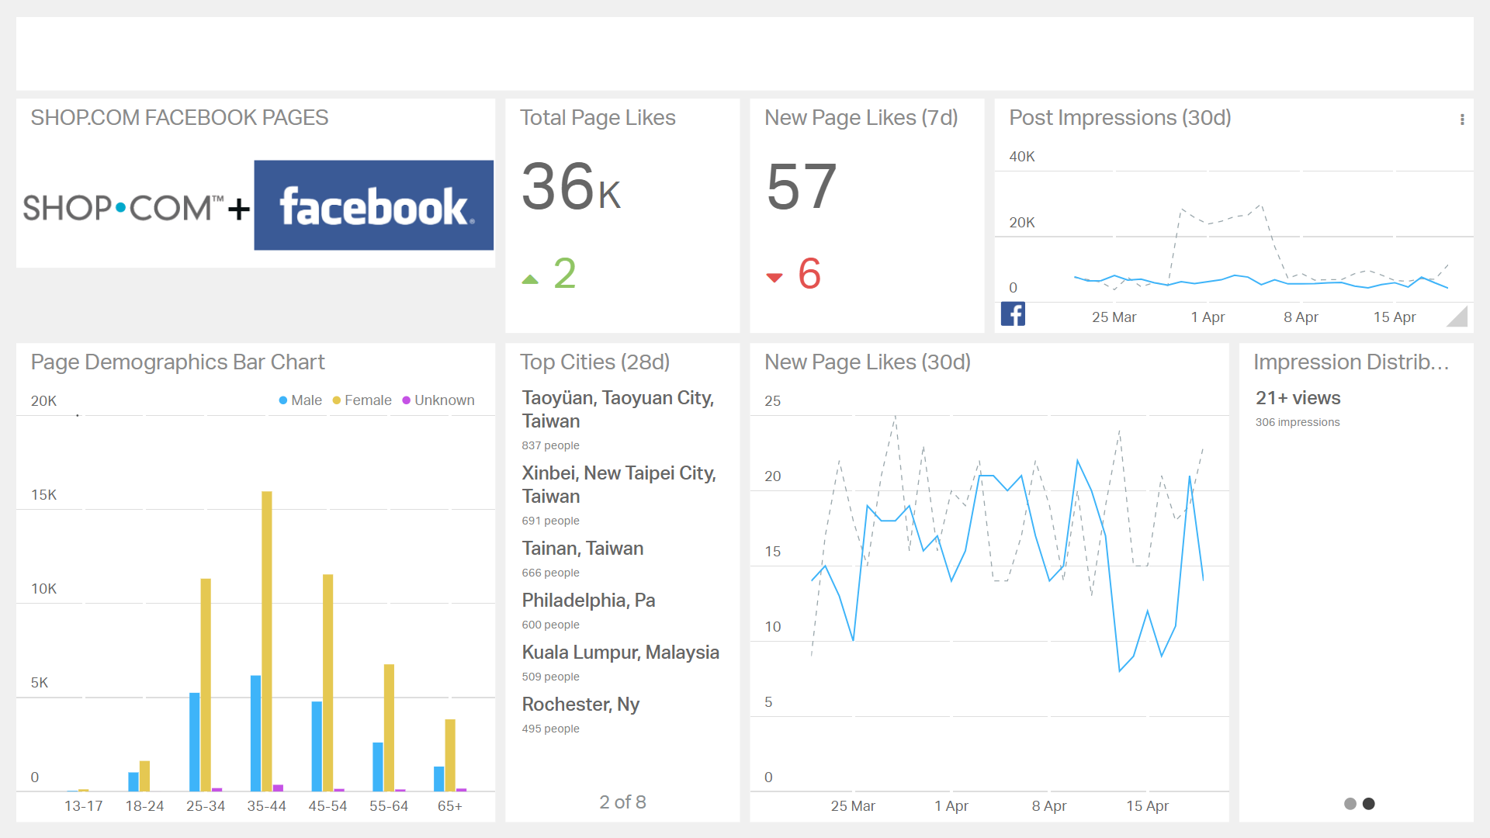
Visualization insights - social media

Slide 16





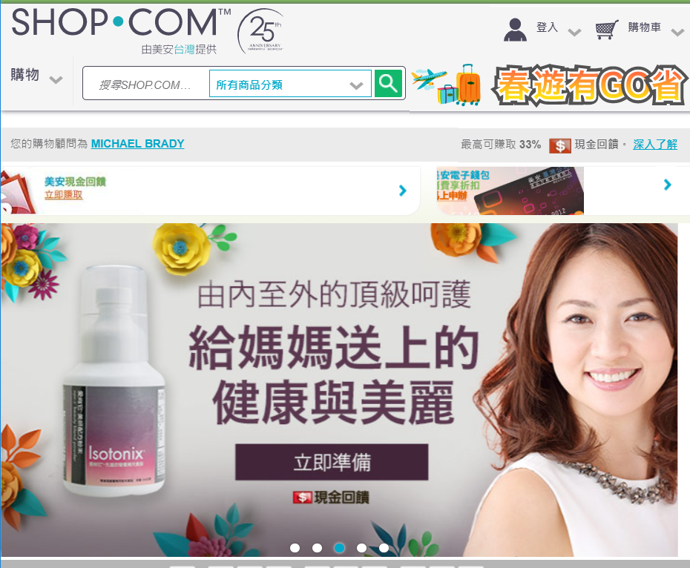

Fastest Path through the Internet
Our Servers
Systems that find the fastest path from the Server to your browser.
10ms
10ms
100ms
255ms
15ms
Faster Page Loads!
Notes:
It is great that we measure and monitor our systems and software to be sure they are fast and reliable.
But it all doesn’t work – if after it leaves our servers, the customer has a bad experience because of “internet issues”.
Here is what we do to address this:
Fastest path.

Slide 17
Fastest Path through the Internet
Our Servers
We load content to servers close to YOU.
10ms
100ms
255ms
15ms
Greatly improves page load performance

Slide 18
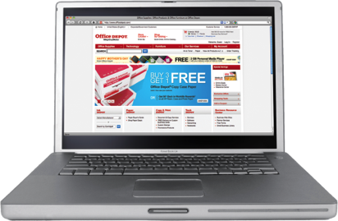


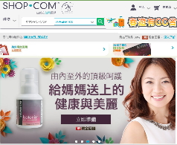







Web Page - Optimization
Fast Connection
Medium Connection
SHOP.COM
Optimization Intelligence
Cellular connection
We Improve Performance by adjusting the Content Based on browser type and connection speed
Notes:
Automated, includes our expertise
With Front End Optimization (FEO) we can make a web page download and render faster by rewriting the HTML and modifying the associated embedded objects. This is a long way of saying that we can make pages faster, and we can make them faster in a way that traditional site acceleration and content delivery services cannot.
To illustrate this, consider the diagram up here. On one side we have developer created content – it is optimized for readability, modularity, maintainability, and many other factors that contribute to good, clean code and an easy-to-update site. Unfortunately, good coding practices occasionally fly in the face of performance oriented best practices.
FEO takes developer created content and crunches through it, producing content optimized for performance. This means that FEO optimized pages will take fewer round trips to put together, will be built up of lighter weight objects, and will have content tweaked in a way that ensures a more responsive feel to end users. And all this is done per browser.

Slide 19
Monitoring: Voice of the Customer
Innovation in Technology
Notes:
To grow the business we must understand the business.
Why would you be part of this company?
We know it is a great company. Great opportunity!
Our company also has GREAT Technology. Not only great technology – but we innovate, we measure, monitor and improve.
We need to understand our technology for
speed/reliability
What are customers are doing? How they use the site?
What do they want?
Big data, visutalization

Slide 20
What is
Voice of the Customer?
Process of Capturing Customer’s Expectations and Preferences
Giving the customer a quality experience
Understanding or Hearing what the customer “Wants and Needs”
Delight the Customer!

Slide 21
Voice of the Customer?
digital intelligence
Capture, manage, and analysis of customer data.
Transparency & insight of customer actions to deliver a complete view of the customer.
Continuously optimize business decisions and customer experiences

Slide 22






Process of “voc”
VISUALIZE
Big Data
Issue Identification
Understand context
ALERT AND MONITOR
Monitor customer experience indicators
Alert on Issues
Feedback from customers
RESOLVE
Fix issues technically
Resolve issues with Customer Experiences
Delight the Customer
QUANTIFY
How many customers?
Impact size?
Enables prioritization
ANALYZE
What is working, what needs improvement
Monitors/Analytics to understand customer behavior
Notes:
VISUALIZE
Big Data
Issue Identification
Understand context
ALERT AND MONITOR
Monitor customer experience indicators
Alert on Issues
Feedback from customers
ANALYZE
What is working, what needs improvement
Monitors/Analytics to understand customer behavior
QUANTIFY
How many customers?
Impact size?
Enables prioritization
RESOLVE
Fix issues technically
Resolve issues with Customer Experiences
Delight the Customer

Slide 23
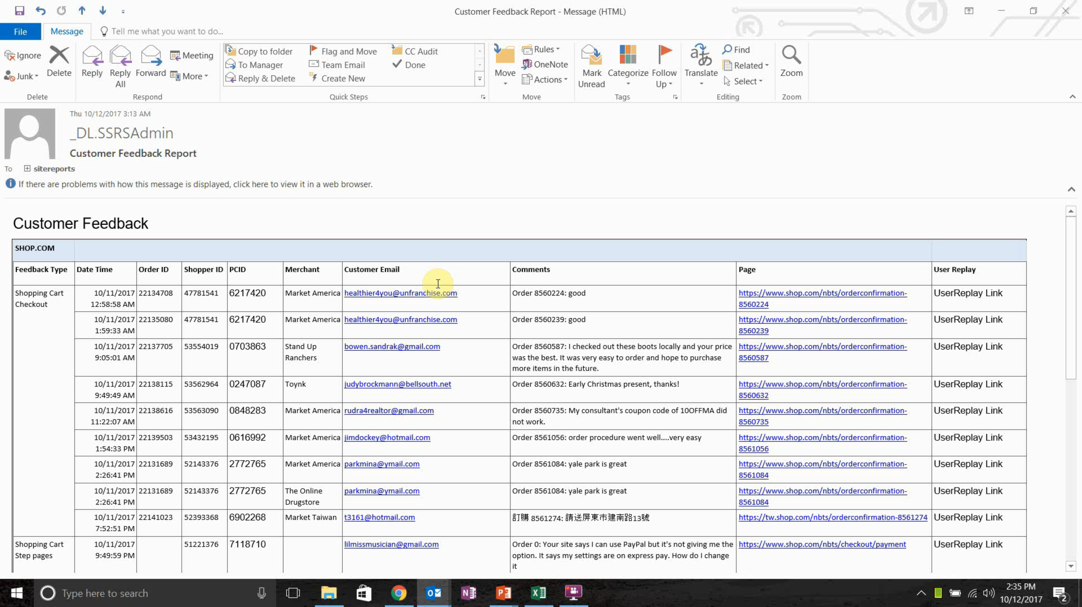
Customer Feedback Report

Slide 24
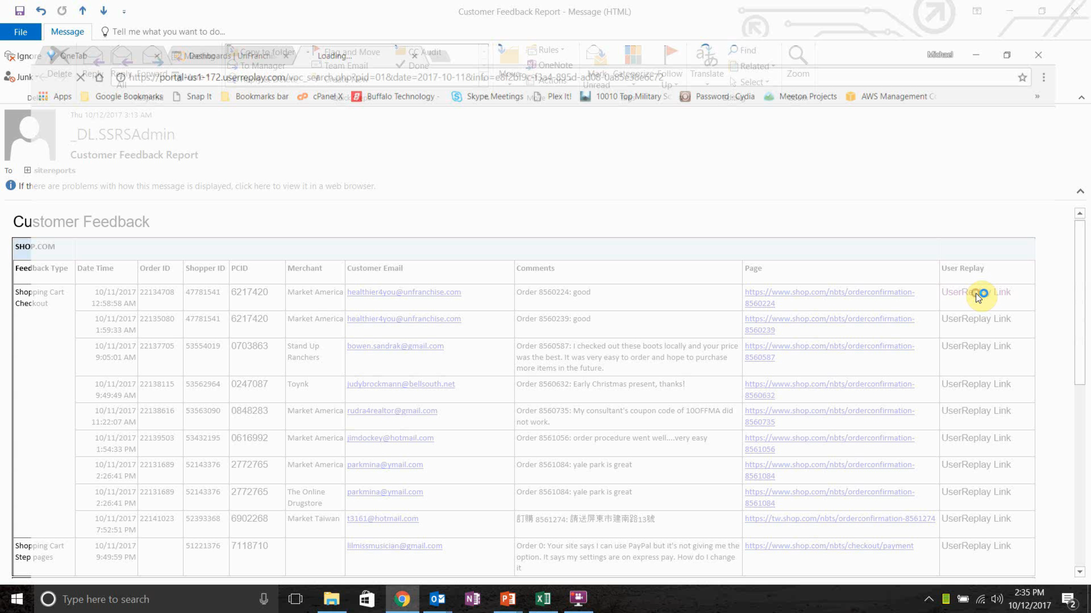

Slide 25
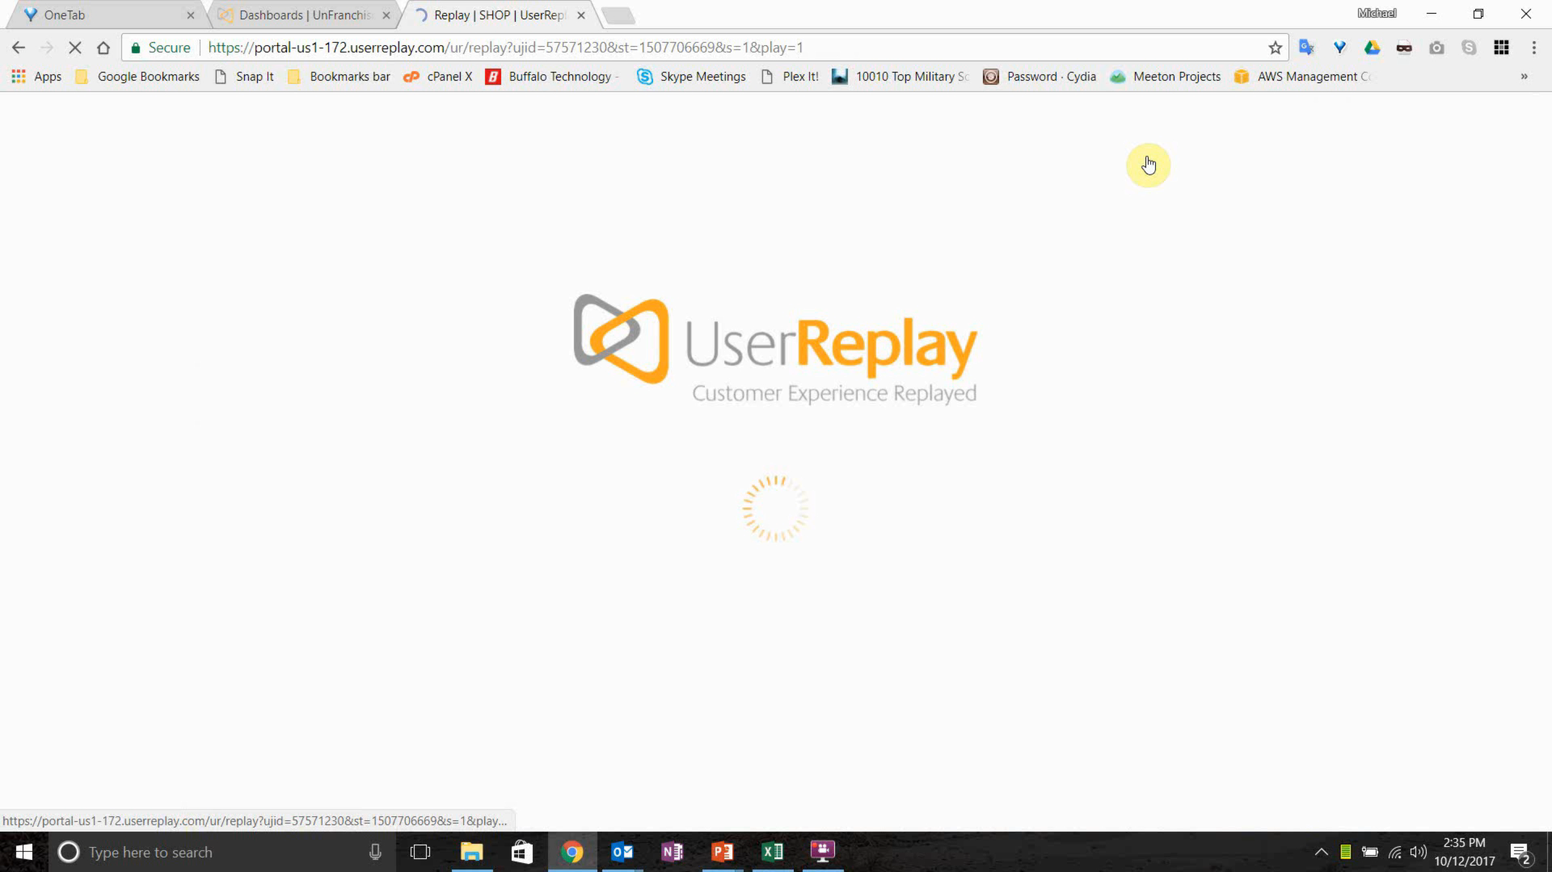

Slide 26


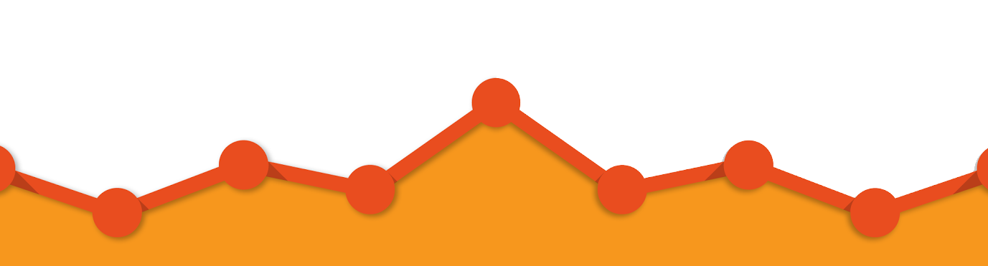
We have great analytics
How would you like your own?
Notes:
We have great analytics.
Wouldn’t it be great – if you could see what is happening on YOUR site?
Your portal. Only yours – just what is happen? Who if visiting? Where are they coming from?
You can.
We have enabled Google Analytics – for your portals, your websites. For SHOP, MotivesCosmetics, - all customer facing sites.

Slide 27

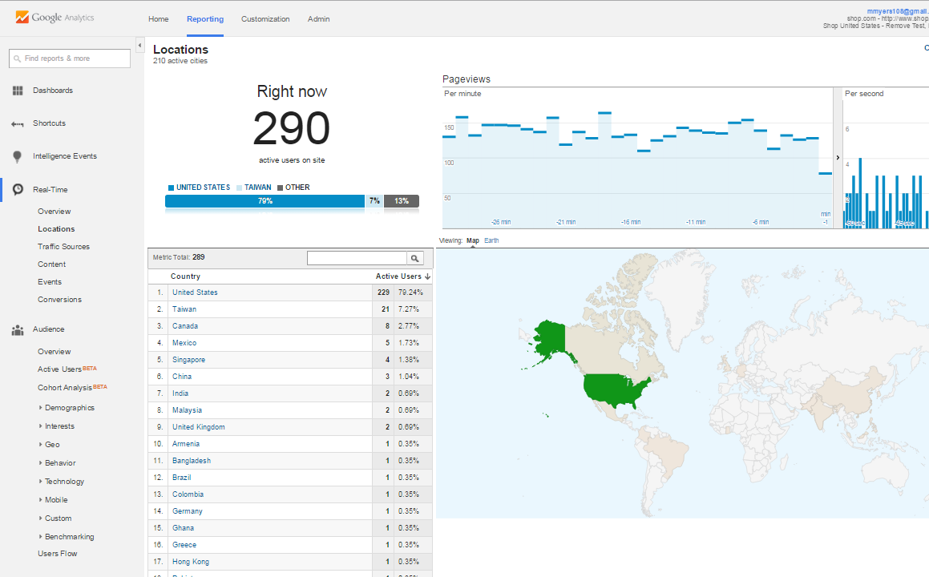
See what visitors are on your site at
any
given
Time
Notes:
See what visitors are on your site –
AT ANY TIME!

Slide 28

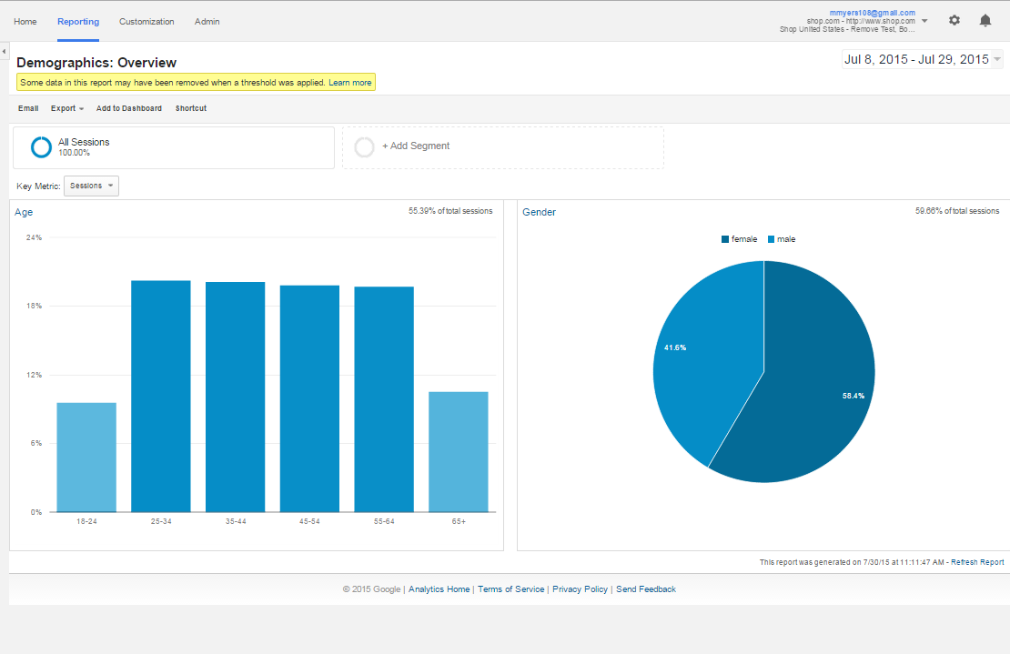
Demographics
Age
Gender
Location
Notes:
Demographics
Who is visiting your site?
Age range
Gender?
Location

Slide 29
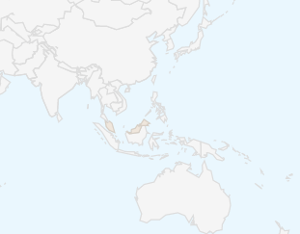

Website
Traffic
  Where traffic is coming from
  Countries
  Devices Used
  Sites They Came From
Notes:
Where is traffic coming from?
Which Countries?
What kind of devices are they using
Which sites did they come from?

Slide 30
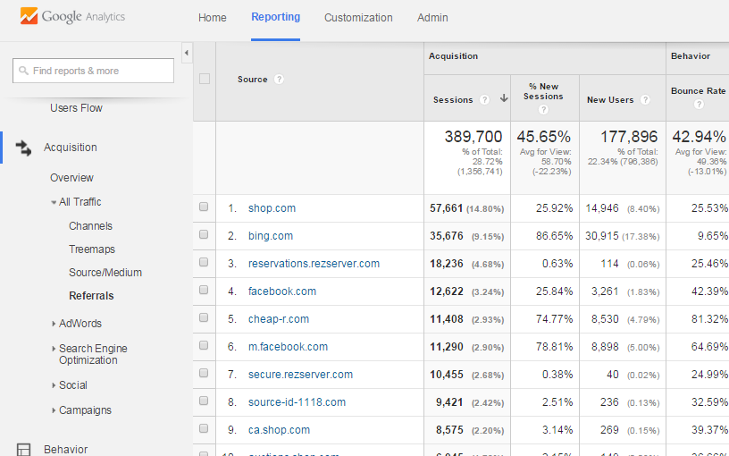
Website Traffic
See the websites
That are
referring
Traffic
Notes:
Website Traffic
See Websites that are referring traffic.
Do you have a blog, or a social media post? See if this is working – you have visibility into tracking if people clicked from your post to your site.

Slide 31

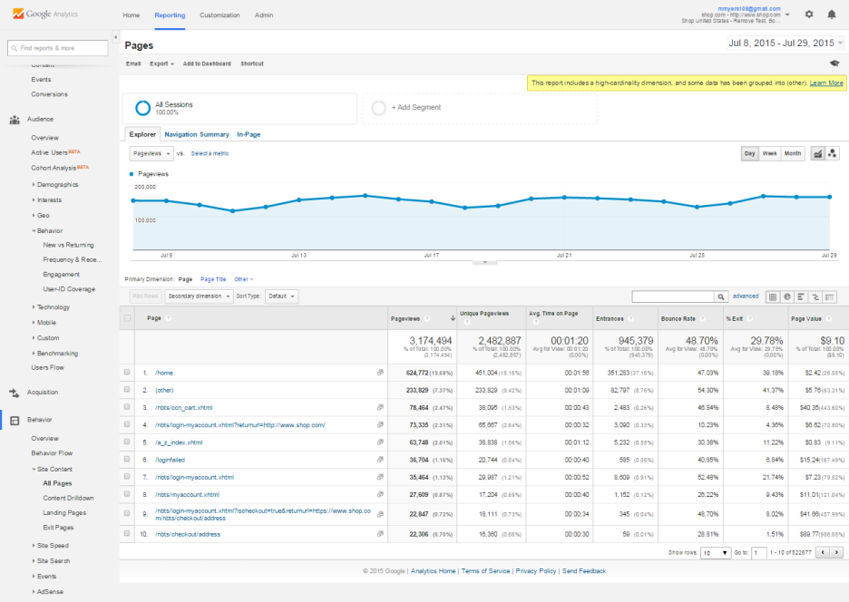
Performance
Details on your site visits
Most Frequently Viewed Pages
Time Spent on Site
Conversion Rate
Notes:
Performance:
Details on your site visits
Most Frequently Viewed Pages
Time Spent on Site
Conversion Rate

Slide 32
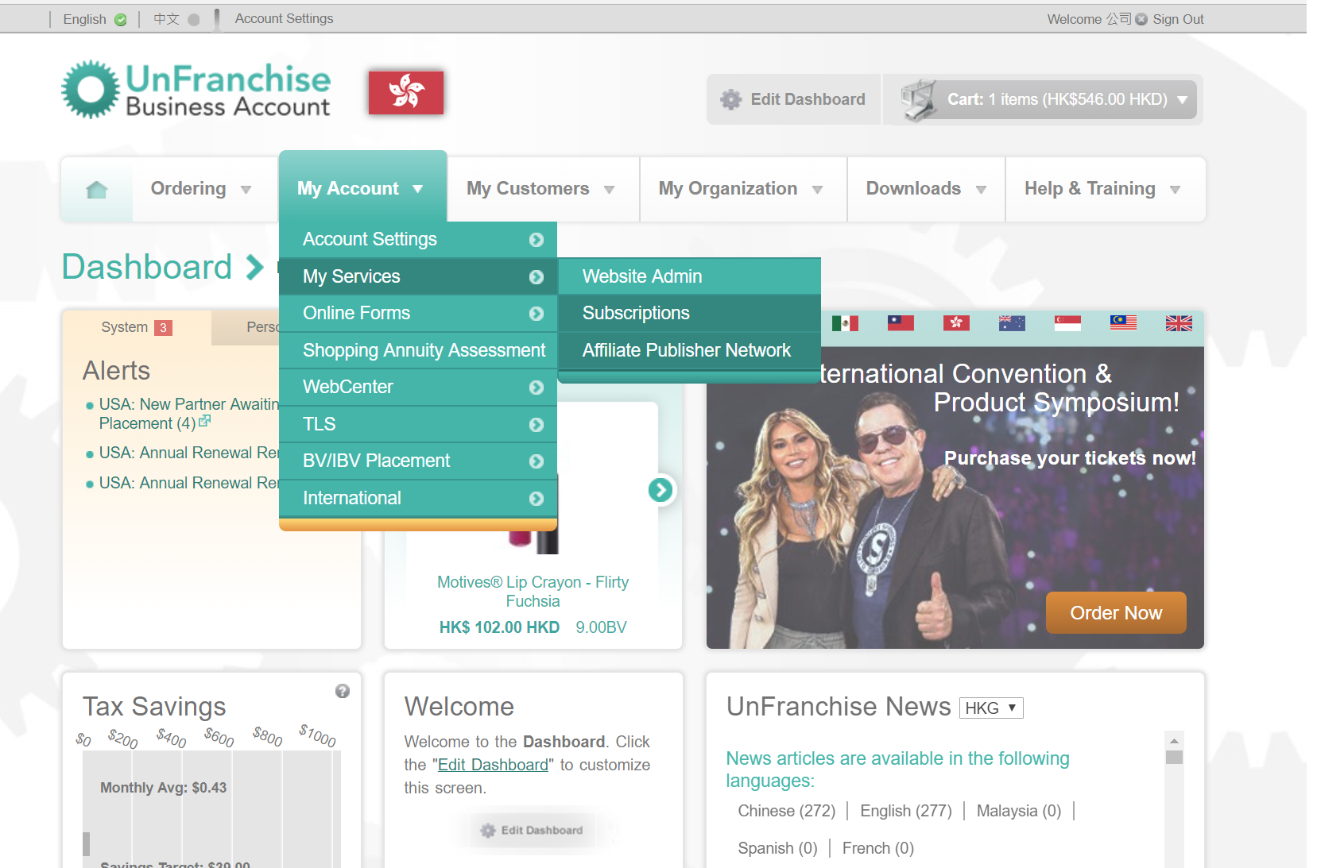
How do I get started?
My Account > My Services > Website Admin
Notes:
You have to go to sign up for Google Analytics first
In UnFranchise
My Account > My Services > Web Admin

Slide 33
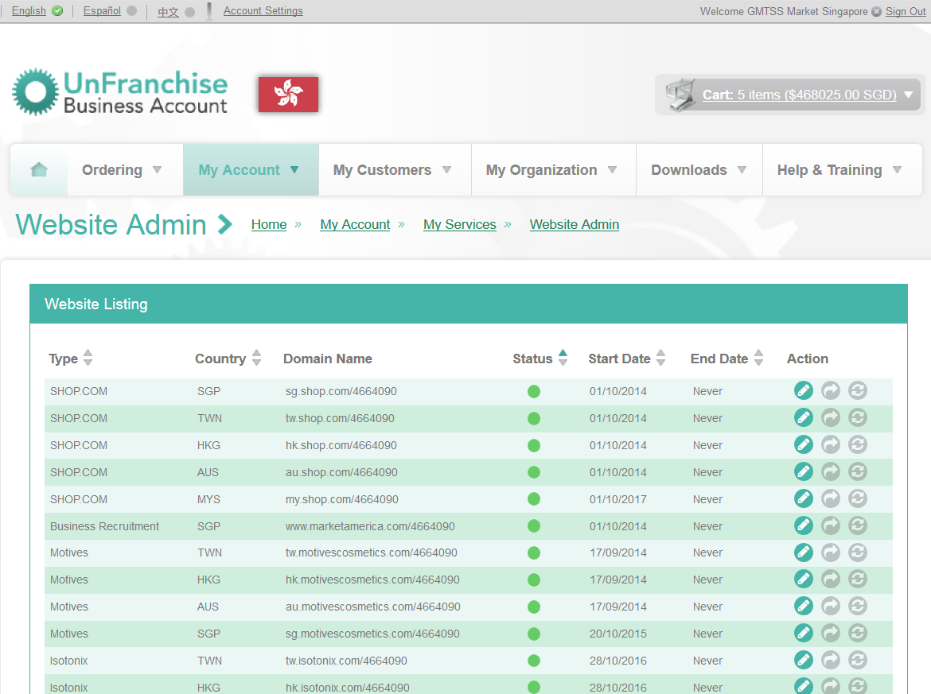
Notes:
Go to: EDIT

Slide 34
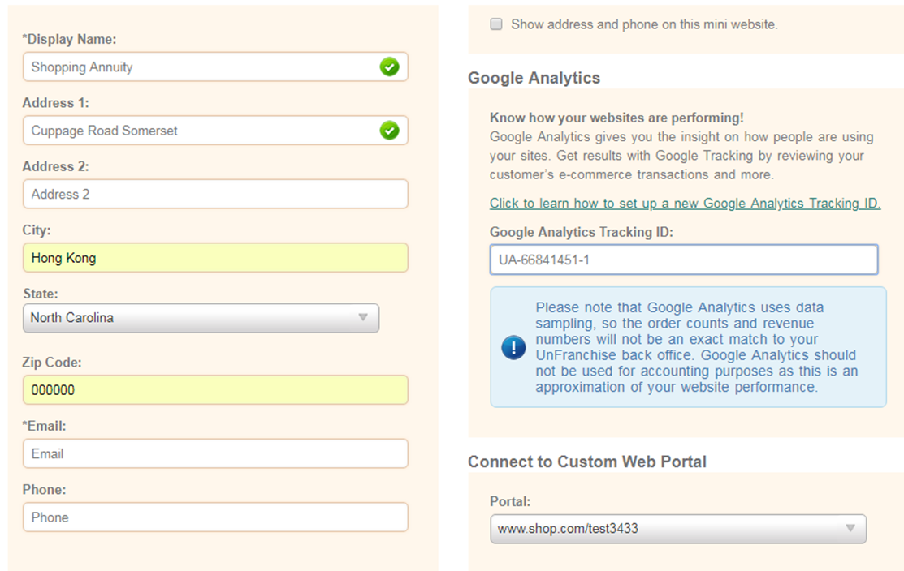
Notes:
You will have a
Google Analytics Tracking ID
From google. Insert this here.

Slide 35

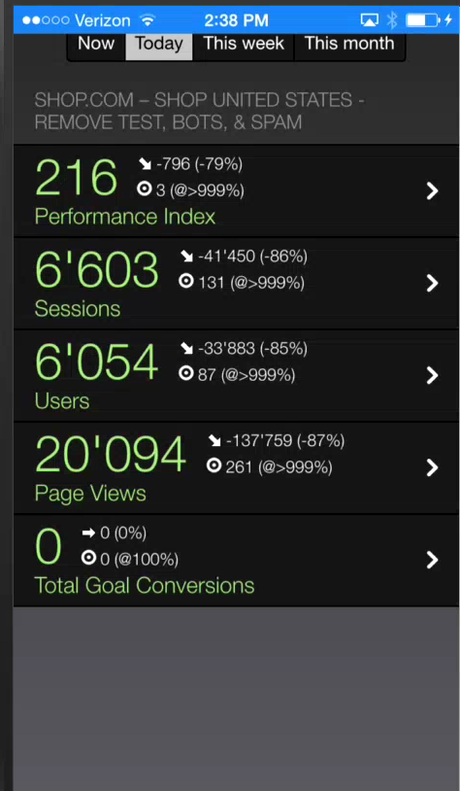


Follow your
Analytics
On the Go
Download The Google Analytic App
To monitor your sites anywhere and any time.
Notes:
Follow GA
Anywhere with the mobile apps from Google.

Slide 36


SHOPPING ANNUITY STRATEGY
MATCHING vs SEARCHING
understand
Customer wants and needs
match
the Best Products & Prices

Slide 37
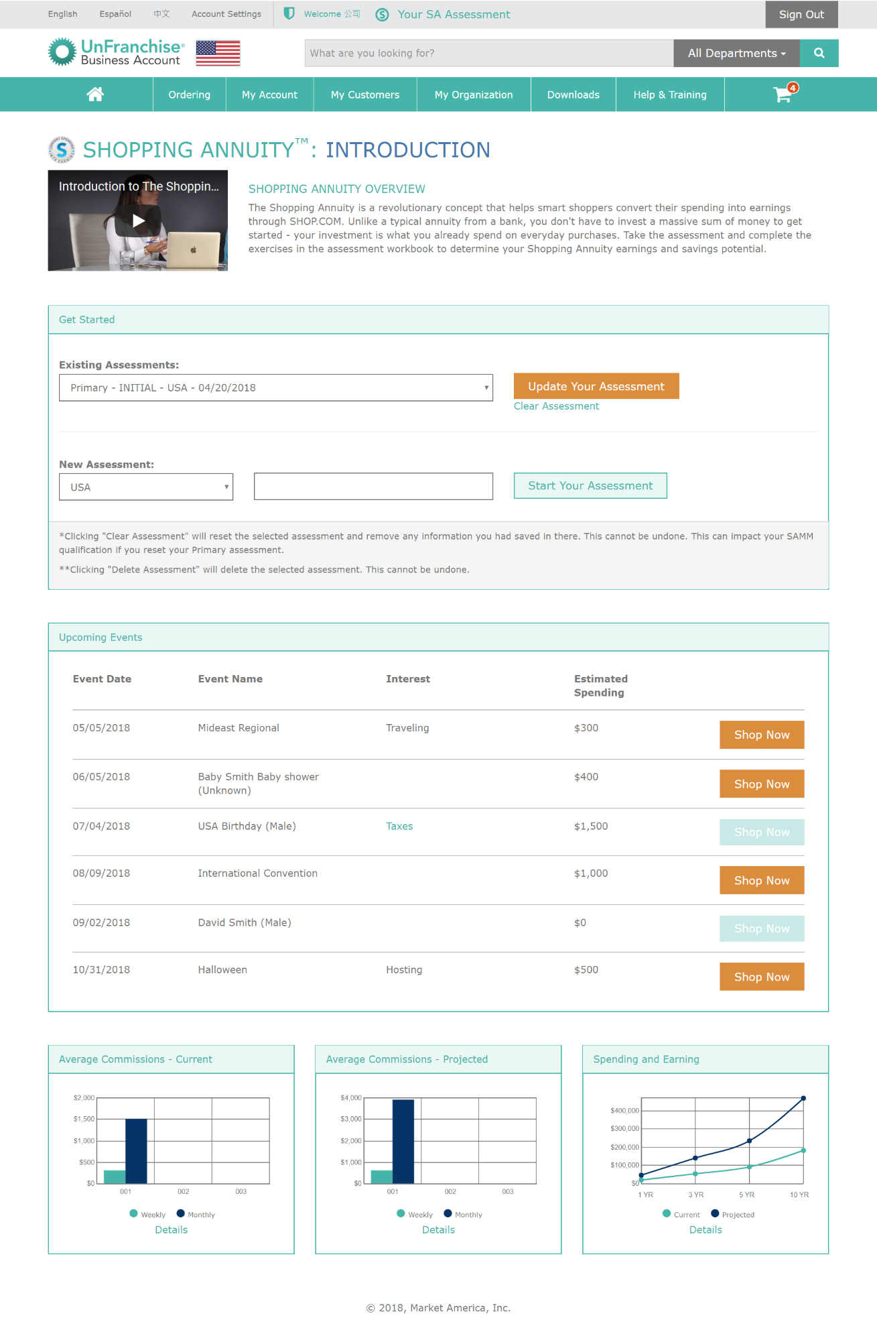
Shopping annuity assessment
Events, Special Occasions
Graphs with Projected
  Savings
  Earnings
  Commissions

Slide 38
Big Data Strategy
Understanding the customer
Customers and UFOs
Shopping Annuity Assessment Data
SHOP Customer
Purchasing Behavior
Website Analytics
Third Party
“Life Style” Data (Brands & Types of Products)
Market Trends

Slide 39
Big Data Strategy
Understanding
products & merchants
Hottest Products
Best Match
Partner Stores & Merchants with the Best
Shipping Options
Prices
Best Bundles

Slide 40
SHOPPING ANNUITY STRATEGY
MATCHING vs SEARCHING
Product Category
(Groceries, Shoes, Shirts, Dresses, etc.)
Narrows selection based on YOUR Preferences
Matches Best
Products & Price
Fast / Easy
“Order & Get” Instead of Searching
SA Assessment
SHOP Customers
Third-Party
Alerts, Notifications for Events
CONVENIENCE

Slide 41


Slide 42


Customers “Likes” are defined as neighborhoods. We make connections using this formula:
We take the connections and define groups.
The formula is called “local clustering coefficient for undirected graphs”

Slide 43

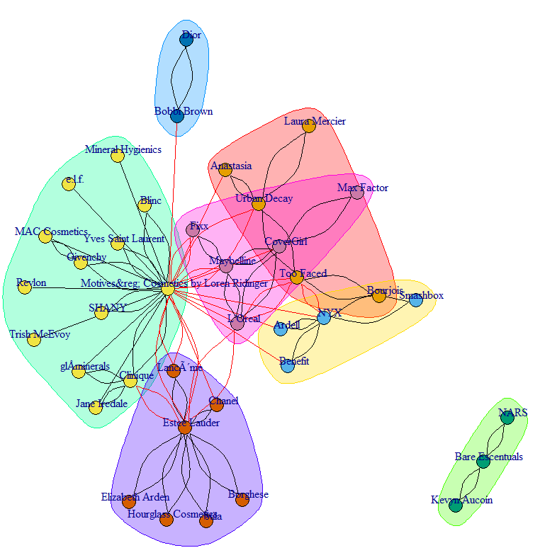
Big Data strategy
Understanding what the customer wants
We can group Customers with Affinity based on Brands & Products

Slide 44
SHOPPING ANNUITY STRATEGY
MATCHING vs SEARCHING
We have leverage with Merchants to get the best prices and best shipping options.
Fast/Easy Order & Get Instead of Searching to Find

Slide 45
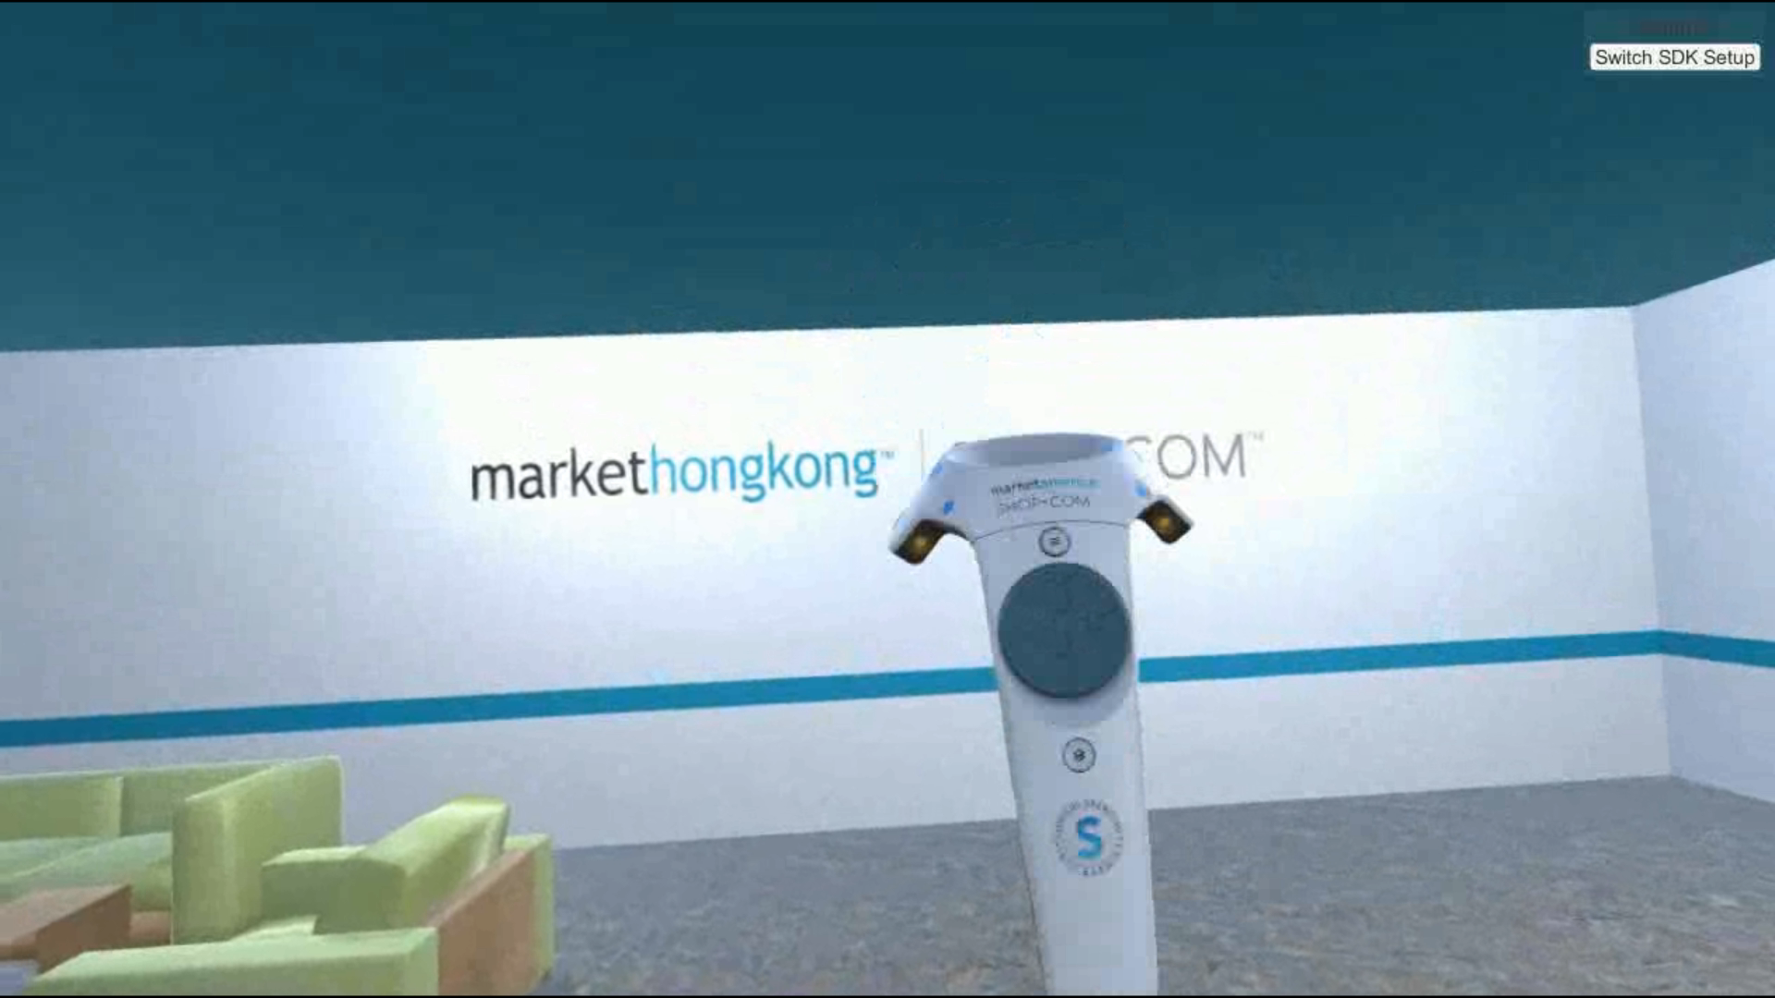
Virtual Reality
Immersive shopping experience
Shop, learn, play, repeat

Slide 46

possibilities are
endless
Notes:
The possibilities are endless

